Slide 1

Evaluation of the Effects of Pre- and Post-Image Processing on Deep Learning Models for Mammogram Enhancement
Made by -Vatshal 21bec1463
Pranav 21bec1507
SUDHANSHU 21BEC1466

Slide 2
Introduction
Integrating deep learning with advanced image processing methods offers significant potential for enhancing mammograms and improving diagnostic accuracy. This study evaluates how pre- and post-image processing techniques affect the performance of deep learning models for mammogram enhancement.
Pre-Image Processing includes noise reduction, normalization, contrast adjustment, resizing, and augmentation to prepare high-quality images for analysis. Deep Learning Models, such as CNNs, then analyze these images for enhancement and feature extraction.

Slide 3
Post-Image Processing techniques refine the model’s outputs, using methods like smoothing and filtering to enhance final image quality and clinical utility.
This evaluation aims to optimize processing workflows and improve deep learning effectiveness in medical imaging.

Slide 4
Brief introduction about breast cancer:
Breast cancer is considered to be one of the most common global health problems, and more than 700,000 women die of breast cancer annually.
It is a type of cancer that forms in the cells of the breast and can occur in women and rarely in men.
The symptoms include a lump in the breast, bloody discharge from the nipple and changes in the shape or texture of the nipple or breast.
It’s treatment depends on the stage of cancer and may consist of chemotherapy, radiation, hormone therapy and surgery.

Slide 5
Mammogram :
A mammogram is an x-ray of the breast.
mammograms are used to look for early signs of breast cancer.
It can be used for either breast cancer screening or for diagnostic purposes.
It helps in detection of breast cancer before it causes signs and symptoms and have been shown to reduce the risk of dying of breast cancer.

Slide 6
Mammography :
Mammography is the process of using low energy xrays to examine the human breast for diagnosis of breast cancer, typically through detection of characteristic masses or microcalcifications.
It is the most widely used method for screening asymptomatic women aiming at the early detection of breast cancer, and has been demonstrated to reduce the cancer-related mortality rate by 30%–70%.

Slide 7
objective of this project:
Assess the impact of pre-processing methods (e.g., noise reduction, normalization) on model performance.
2. Analyze how post-processing techniques (e.g., smoothing, filtering) refine mode outputs.
Optimize the integration of these techniques to improve mammogram quality and
diagnostic accuracy.

Slide 8
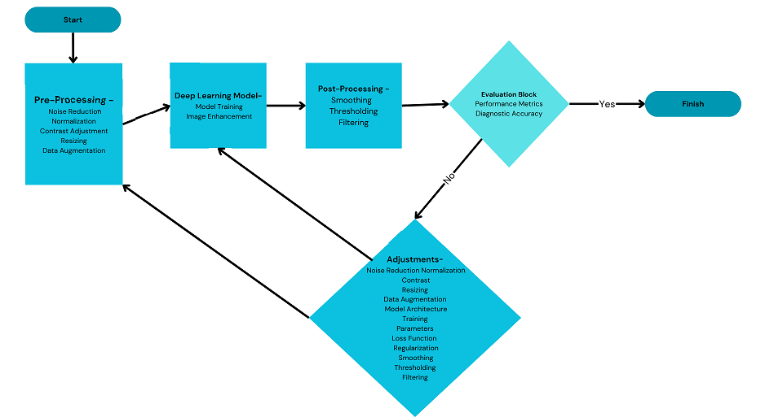
block diagram:

Slide 9
Analysis of Image Processing for Digital X-Ray
Akshay Trimbak Chikhalekar
Dept. of MCA, Dr. G.D. Pol Foundation YMT College of Management, Maharashtra, India
The paper explores enhancing digital x-ray images using image processing techniques to improve diagnostic accuracy. It addresses challenges like noise and blurring in traditional x-rays. The proposed solution includes noise reduction via median filtering, image preprocessing, edge detection, and feature extraction methods. Digital x-ray sensors capture images, which are then processed to enhance clarity. The techniques significantly improved image quality, achieving around 85% accuracy in diagnostic clarity. The study concludes that advanced processing can greatly enhance x-ray diagnostics, with future potential for integrating 3D imaging techniques.

Slide 10
The impact of pre- and post-image processing techniques on deep learning frameworks: A comprehensive review for digital pathology image analysis
Massimo Salvi, U. Rajendra Acharya, Filippo Molinari , Kristen M. Meiburger
This is a review paper on the impact of pre-processing and post-processing techniques on deep learning frameworks for digital pathology image analysis. Convolutional Neural Networks (CNNs) are the most commonly used deep network for image analysis. However, CNNs have some drawbacks such as difficulty to interact with a single layer and black-box effect. Digital pathology uses histology slides to diagnose cancer. There are many challenges in digital pathology including small number of labeled images, big data and stain variability. Pre-processing algorithms are used to minimize visible variability in staining and its impact on diagnostic quality. Stain color normalization is a common pre-processing step. The stain normalization methods can be classified into global color normalization, color normalization after stain separation, and color transfer using deep networks.

Slide 11
Challenging deep learning models with image distortion based on the abutting grating illusion
Jinyu Fan , Yi Zeng
Investigates deep learning models' ability to perceive illusory contours, specifically those created using abutting gratings. Models tested on AG-MNIST, high-resolution AG-MNIST, and AG-silhouettes performed poorly compared to their accuracy on original images. Higher image resolution improved illusion perception, indicating the importance of detail preservation.DenseNet121 and ResNet18 performed worse than Alex Net, which achieved some success in specific grating directions and intervals. The study emphasizes the need for comparing human and machine performance on illusory contours. Humans excel, while current models struggle.
Overall, the study highlights a fundamental limitation of deep learning models – their inability to perceive illusory contours effectively, suggesting a gap in how humans and machines process visual information.

Slide 12
Detection & Diagnosis of COVID-19 from CXR Images Through VGG19 Transfer Learning Model
Rudresh Pillai, Neha Sharma, Rahul Chauhan, Garima Verma and Rupesh Gupta
This research paper proposes a deep learning model for accurately diagnosing COVID-19 from chest X-ray images. The model, based on VGG19 transfer learning, achieves an impressive 94.85% accuracy on a dataset of 21,165 images. By leveraging deep learning techniques, the model effectively extracts relevant features from chest X-rays, enabling precise classification of COVID-19 cases. This innovative approach has the potential to significantly improve healthcare management during the COVID-19 pandemic by facilitating rapid and accurate diagnosis, leading to more efficient patient triage and resource allocation. Further research and development can refine the model's performance and expand its applicability in real-world clinical settings.

Slide 13
Research on Digital Media Image Processing and Enhancement System for Computer Deep Learning Vision
Huiyu Lin
This research paper presents a novel approach for enhancing image boundary characteristics using deep belief networks and object-oriented technology. The proposed method effectively extracts shape gradient features and employs a multi-feature fusion technique to improve image clarity and precision. Experimental results demonstrate that the enhanced images exhibit superior boundary characteristics compared to traditional methods. The proposed approach offers a valuable contribution to the field of image processing by providing a more accurate and efficient method for enhancing image boundaries.

Slide 14
PAIRFLOW: ENHANCING PORTABLE CHEST X-RAY BY FLOW-BASED DEFORMATION FOR COVID-19 DIAGNOSING
Ngan Le, James Sorensen†, Toan Duc Bui, Arabinda Choudhary, Khoa Luu, Hien Nguyen
The proposed deep learning framework significantly enhances the quality of portable chest X-rays (pCXRs), improving their diagnostic accuracy for conditions like COVID-19. By aligning pCXRs with conventional chest X-rays and applying a PairFlow network, the method effectively improves image clarity, contrast, and detail preservation. This leads to faster and more accurate diagnoses, aiding physicians in critical care settings. The framework demonstrates promising results in quantitative metrics and visual analysis, making it a valuable tool for improving the diagnostic value of pCXRs.

Slide 15
Learning to Recognize Chest-Xray Images Faster and More Efficiently Based on Multi-Kernel Depthwise Convolution
MENGJIE HU , HEZHENG LIN, ZIMENG FAN, WENJIE GAO, LU YANG , CHUN LIU , AND QING SONG
The research paper proposes a novel method called Multi-Kernel Depthwise Convolution (MD-Conv) for chest X-ray recognition. MD-Conv is a lightweight and efficient approach that combines depthwise convolution kernels of different sizes within a single layer, allowing the network to learn multi-scale features without introducing additional complexity. The authors evaluate MD-Conv on two datasets and demonstrate its effectiveness in improving recognition performance while reducing computational costs. The results suggest that MD-Conv has the potential to enhance the accuracy and efficiency of chest X-ray recognition, making it a valuable tool for medical image analysis.

Slide 16
Deep Learning: A Comprehensive Overview on Techniques, Taxonomy, Applications and Research Directions
Iqbal H. Sarker
The article provides a comprehensive overview of deep learning (DL) techniques, including a taxonomy based on different types of real-world tasks. It highlights the importance of DL in the Fourth Industrial Revolution and its wide applicability across various domains. However, building effective DL models can be challenging due to the dynamic nature of real-world problems and the black-box nature of DL methods. The article aims to address this by presenting a structured view on DL techniques and their potential applications.

Slide 17

THANK YOU.

